Slide 1
MSc Project
(CMP060L050H)
Viva Presentation
Detecting Supply Chain and Dependency Confusion Attacks in Open-Source Ecosystems
Student Name: Shivani Burma
Date:
Supervisor: Professor Badis
Second Marker:
Notes:
Good morning everyone. I am Shivani Burma and today I will be presenting my dissertation: "Detecting Supply Chain and Dependency Confusion Attacks in Open-Source Ecosystems. This research aims at enhancing the security of software supply chains by introducing a lightweight machine learning based framework that can identify malicious Python packages prior to installation. It integrates package metadata analysis, machine learning algorithms, and an interactive Streamlit application, enabling developers to detect suspicious packages at an early stage and minimize cybersecurity risks without compromising computational efficiency.

Slide 2


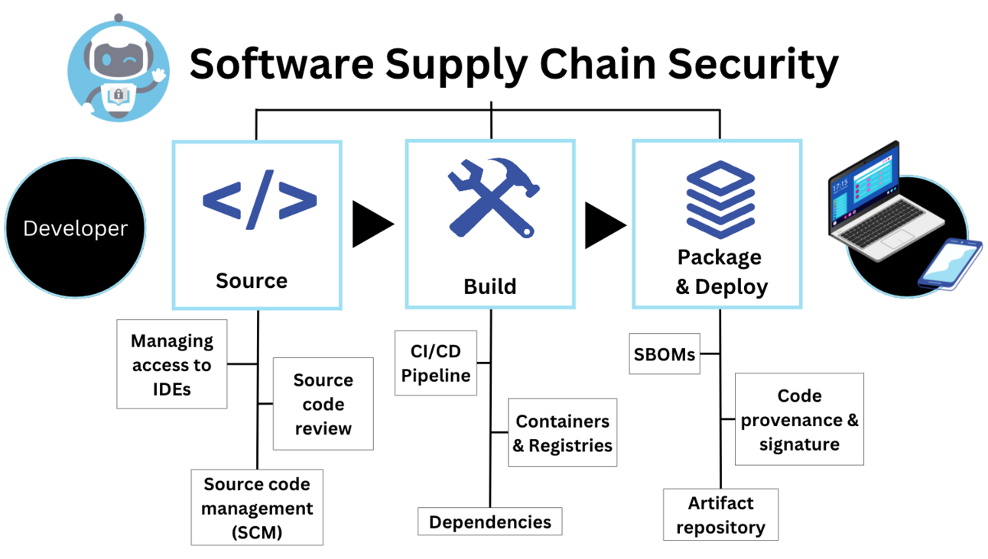
Project Context
Software Supply Chain Security
Open-source software is widely used in modern software development.
PyPI hosts thousands of publicly available Python packages.
Developers frequently rely on third-party dependencies.
Malicious packages increasingly target trusted repositories.
Supply chain attacks threaten software integrity and security.
Key Takeaway
Open-source ecosystems require proactive protection against malicious package attacks.
Notes:
Open-source software is indispensable in the world of software development today, allowing developers to use libraries and frameworks to save time and money in development. Developers install thousands of packages every day from platforms like Python Package Index (PyPI). But all this dependency has also made the software supply chain risky. With public repositories being the target of criminals, it must be increasingly crucial to be able to detect malicious packages that are disguised as legitimate. Hence, the security of packages has become a major research challenge in cybersecurity.

Slide 3
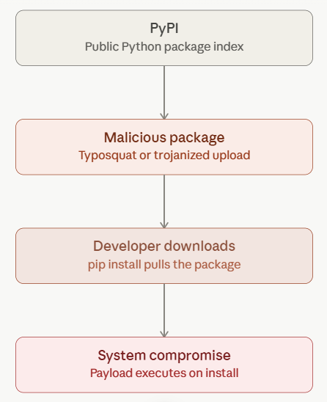
Problem Statement
Research Problem
Existing Challenges
Dependency confusion attacks exploit package resolution.
Typosquatting mimics legitimate package names.
Static analysis is computationally expensive.
Dynamic analysis detects threats only after execution.
Existing methods increase security cost and response time.
Proposed Solution
Develop a lightweight ML framework capable of detecting suspicious packages before installation.
Key Message
Early detection significantly reduces software supply chain risks.
Notes:
The major issue that is being solved in this research is increasing dependency confusion attacks and Typosquatting attacks in open-source repositories. Current threat detection methods are primarily based on static analysis and/or dynamic analysis, and these methods are both costly and only detect threats after packages are downloaded or run. This brings big risks to the developer and organisations. To solve this problem my research suggests lightweight machine learning framework which examines the package metadata before installation for early and efficient detection of attacks.

Slide 4
Aim and Objectives
Research Aim
Develop a lightweight machine learning framework that identifies suspicious Python packages before installation using publicly available package metadata.
Objectives
Investigate software supply chain attacks.
Collect metadata from PyPI.
Construct labelled datasets.
Engineer metadata features.
Train multiple ML classifiers.
Validate using OpenSSF repository.
Deploy an interactive Streamlit application.
Notes:
The literature review was conducted to look at the available methods for detecting malicious packages, which are static analysis, dynamic analysis and metadata based detection, machine learning methods. Static and dynamic techniques have good detection power, but they consume a lot of computation resources. An alternative is to use metadata-based detection, which is lightweight and can be used for pre-installation analysis. Another gap in the research was found, since very few studies are directed towards detecting dependency-confusion and typosquatting attacks using only package metadata. This was the motivation for the proposed framework.

Slide 5
Literature Review
Existing Detection Techniques
Method | Strength | Limitation
Static Analysis | Accurate | High computational cost
Dynamic Analysis | Runtime behaviour detection | Time-consuming
Metadata Analysis | Lightweight | Limited behavioural information
Machine Learning | Early prediction | Requires quality datasets
Research Gap
Limited research focuses on metadata-only detection.
Few frameworks detect dependency confusion before installation.
Need for lightweight and scalable solutions.
Key Takeaway
Metadata-driven ML provides an efficient pre-installation detection approach.
Notes:
The literature review was conducted to look at the available methods for detecting malicious packages, which are static analysis, dynamic analysis and metadata based detection, machine learning methods. Static and dynamic techniques have good detection power, but they consume a lot of computation resources. An alternative is to use metadata-based detection, which is lightweight and can be used for pre-installation analysis. Another gap in the research was found, since very few studies are directed towards detecting dependency-confusion and typosquatting attacks using only package metadata. This was the motivation for the proposed framework.

Slide 6
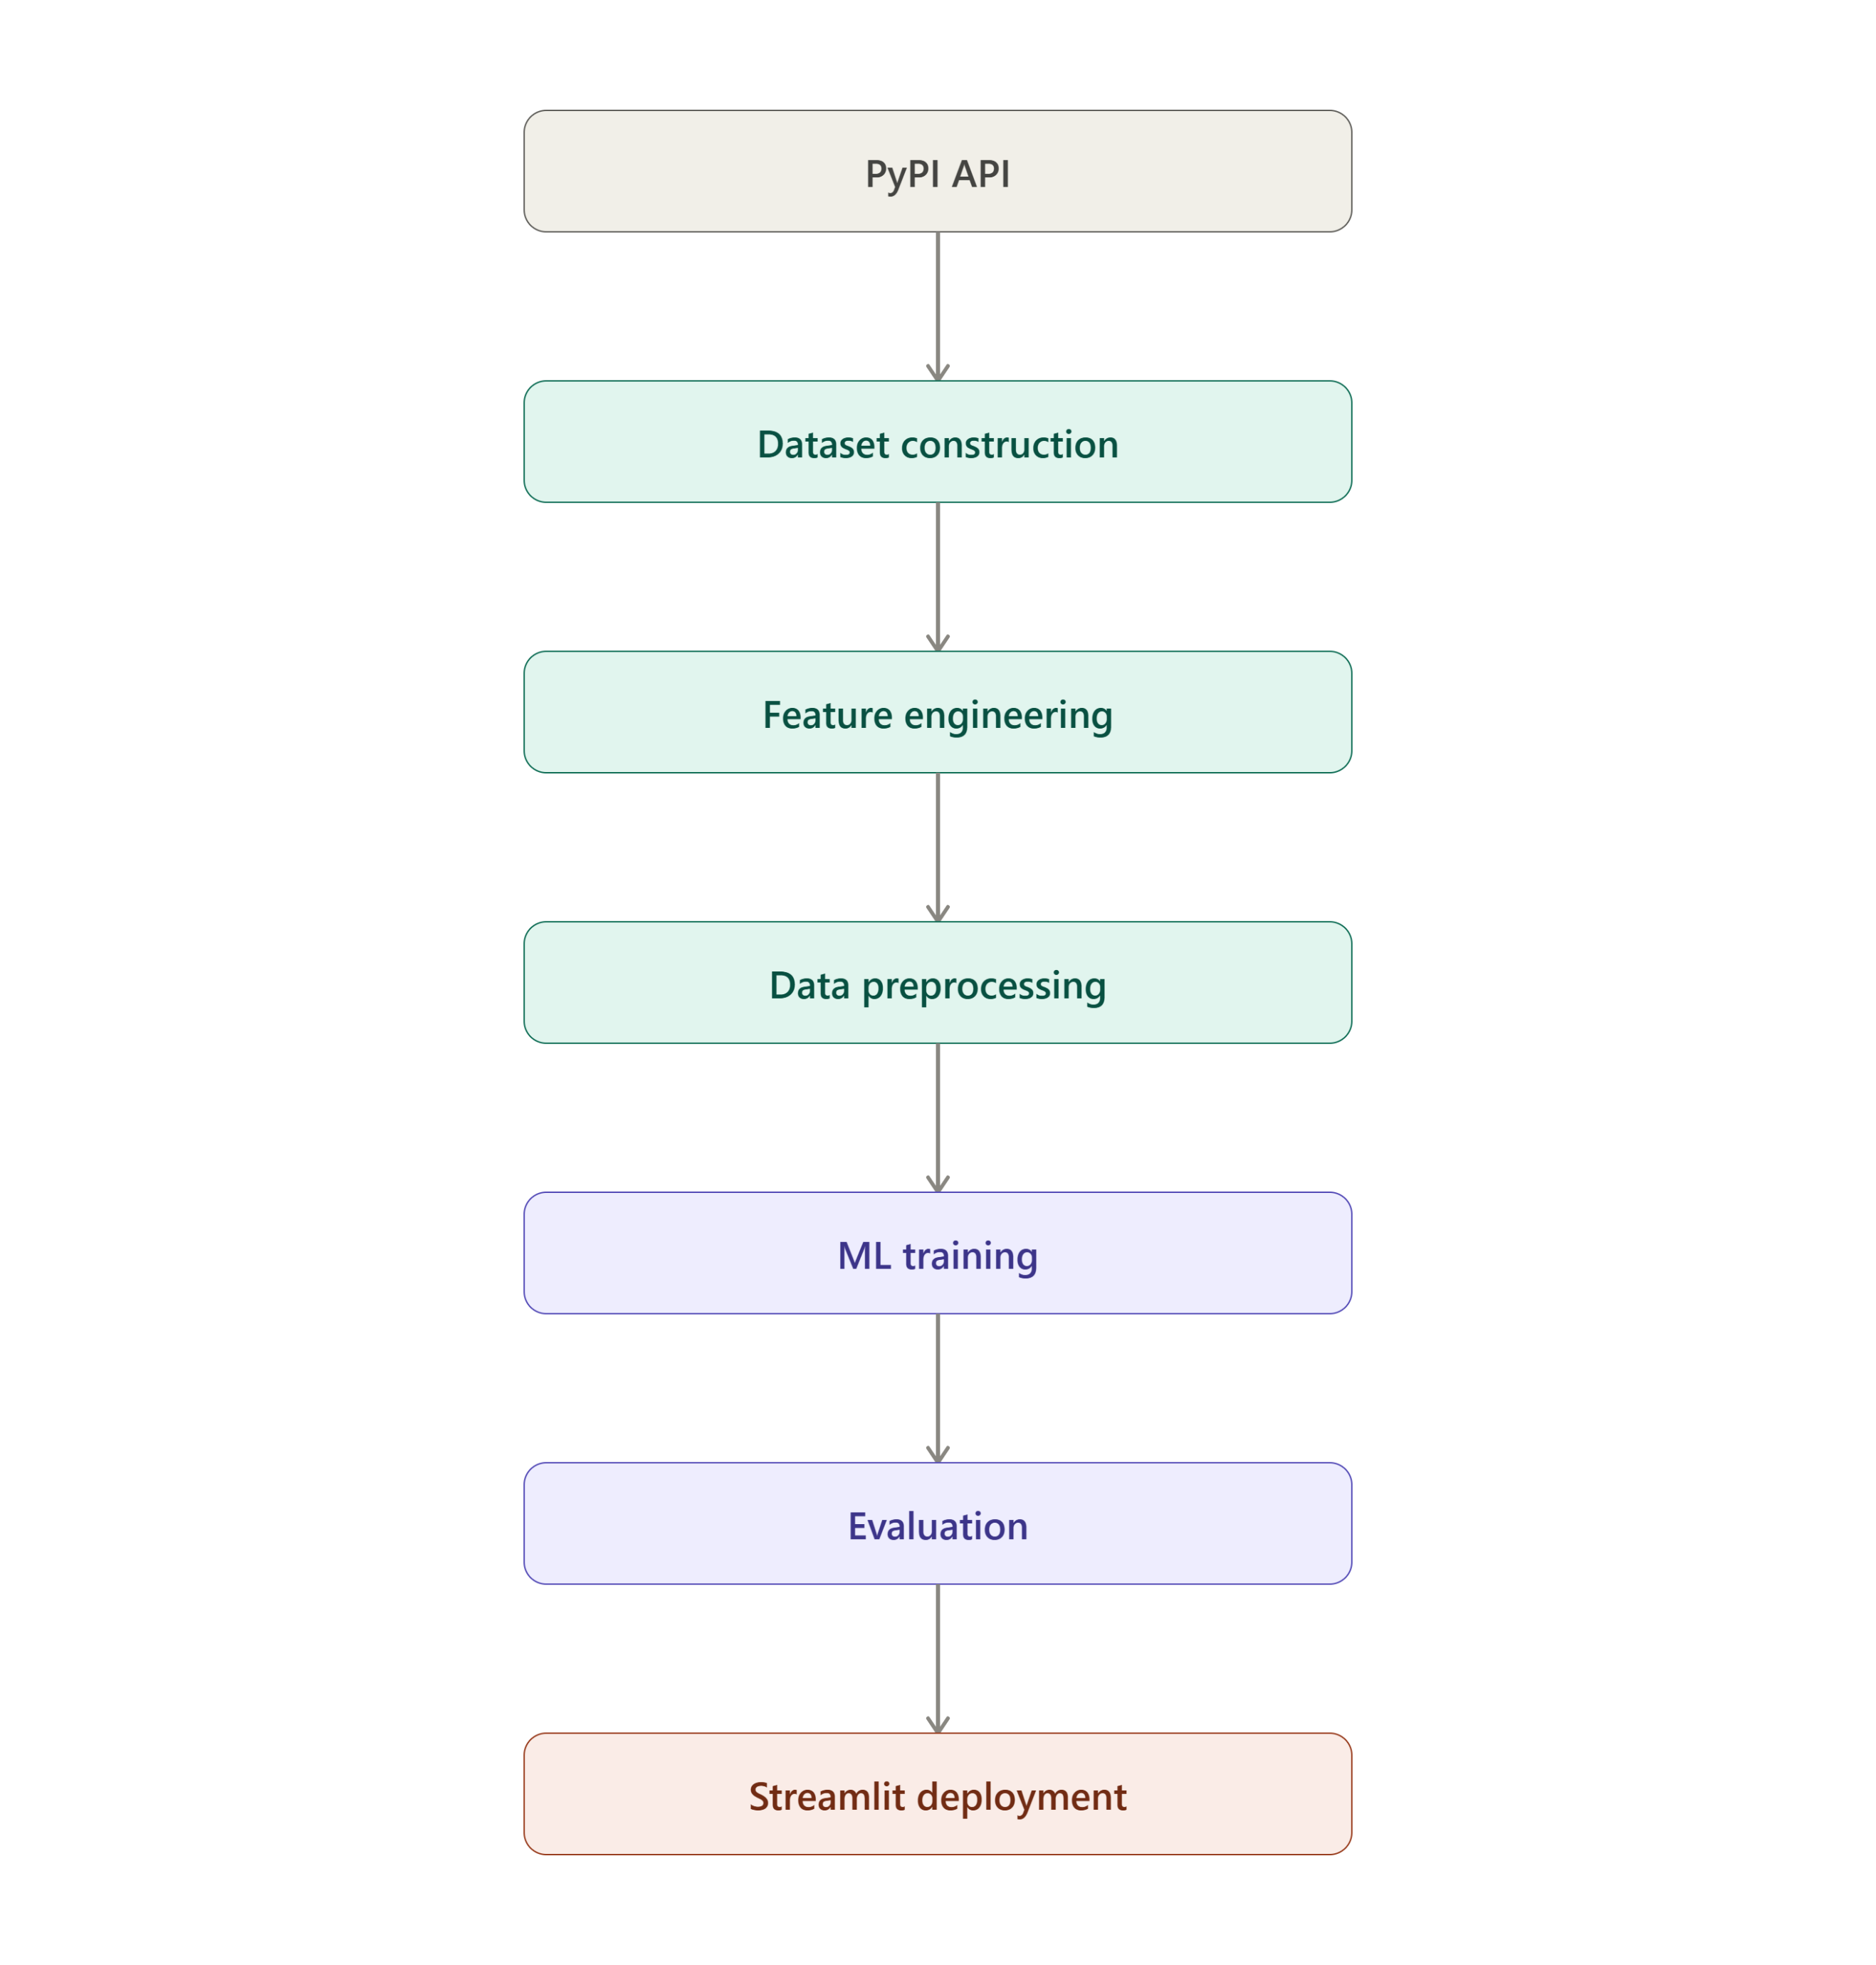
Research Methodology
Research Approach
Quantitative experimental research
Metadata collection using PyPI API
Synthetic typosquatting generation
External validation using OpenSSF
Tools
Python
RapidFuzz
Scikit-learn
Streamlit
Notes:
The method used in this research was an experimental method with quantitative approach. The PyPI API was used to gather metadata whereas common typosquatting techniques were used to create some of the names for the packages. External validation was performed using more packages from the OpenSSF repository. Duplicate removal, missing value analysis, SMOTE class balancing, feature scaling and train-test splitting were then performed on the dataset. Lastly, three supervised machine learning algorithms were trained and tested using typical classification metrics and then the chosen model was deployed in a Streamlit application.

Slide 7
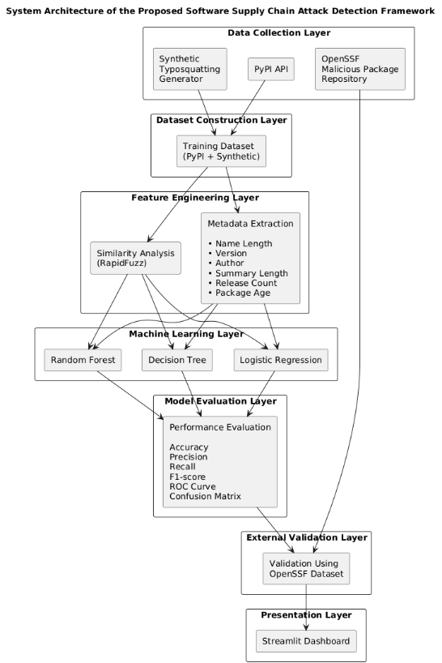
Proposed System Architecture
Framework Components
Data Collection Layer
Dataset Construction Layer
Feature Engineering Layer
Machine Learning Layer
External Validation Layer
Streamlit Presentation Layer
Why this Architecture?
Modular
Scalable
Lightweight
Easy deployment
Key Takeaway
Layered architecture supports efficient pre-installation threat detection.
Notes:
This slide shows the general architecture of the proposed work. This system starts by gathering metadata from PyPI and malicious package information from OpenSSF. The collected data is organised into training datasets before feature engineering extracts important metadata characteristics. These features are then fed into multiple machine learning models to train. The best model is then tested on the external data, and then deployed to a Streamlit dashboard which allows users to work with an interactive package risk prediction system.

Slide 8
Machine Learning Models
Models Evaluated
Logistic Regression
Baseline classifier
Simple and interpretable
Decision Tree
Captures non-linear relationships
Highest overall performance
Random Forest
Ensemble classifier
Robust comparison model
Evaluation Metrics
Accuracy
Precision
Recall
F1-score
ROC Curve
Key Message
Decision Tree was selected as the final prediction model.
Notes:
The training set contained 802 package records, 98 of which were legitimate packages, while 704 suspicious packages, created by typosquating, were included. Data from an independent OpenSSF data set was used for external validation. To make machine learning possible, five numerical characteristics of the packages were created: similarity score, package name length, summary length, release count, and package age. The proposed solution is lightweight and computationally efficient because it doesn't require analyzing the source code or running the software; rather, it relies on these metadata features to recognize suspicious packages.

Slide 9
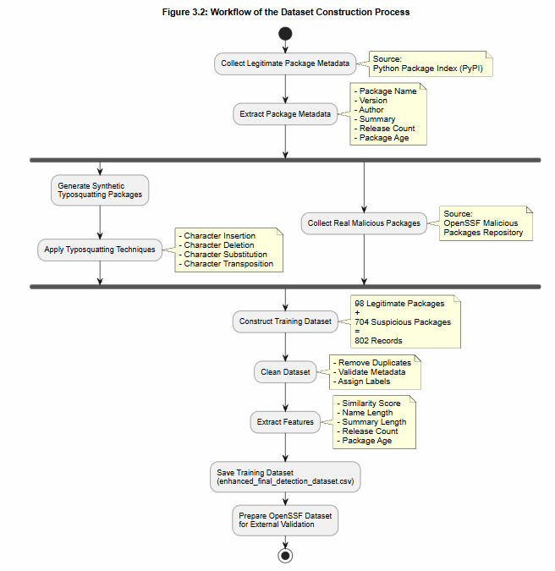
Dataset & Feature Engineering
Dataset Construction
Training Dataset
98 legitimate packages
704 suspicious packages
802 total records
External Validation
100 malicious packages from OpenSSF
Engineered Features
Similarity Score
Name Length
Summary Length
Release Count
Package Age
Key Takeaway
Metadata features enable lightweight attack detection without executing code.
Notes:
Three supervised machine learning algorithms were used and evaluated: Logistic Regression, Decision Tree, and Random Forest. The baseline classifier was Logistic Regression and the Decision Tree classified complex non-linear relationships within the metadata. Random Forest was added to enhance the robustness from ensemble learning. The accuracy, precision, recall, F1 score, confusion matrix and ROC curves were used to evaluate each model. After comparative analysis, the Decision Tree model gave best overall performance and hence was considered as the final prediction model.

Slide 10
Results
Performance Evaluation
Include
Model Accuracy Chart
ROC Curve
Confusion Matrix
Findings
Decision Tree achieved the highest performance.
Metadata features successfully distinguished suspicious packages.
External validation confirmed model generalisation.
Lightweight approach reduced computational overhead.
Highlight
Best Model: Decision Tree
Notes:
The experimental outcomes showed that machine learning is a promising approach for identifying suspicious packages and legitimate ones using the metadata. The Decision Tree (DT) classifier gave the highest overall performance based on the selected evaluation metrics when compared with the other classifiers. The reliability of the proposed framework was additionally validated by the ROC curve analysis and confusion matrices. This was further confirmed by external validation in real malicious packages from the OpenSSF repository, where the model was found to have good generalisation performance when real malicious package samples were not seen during training.

Slide 11
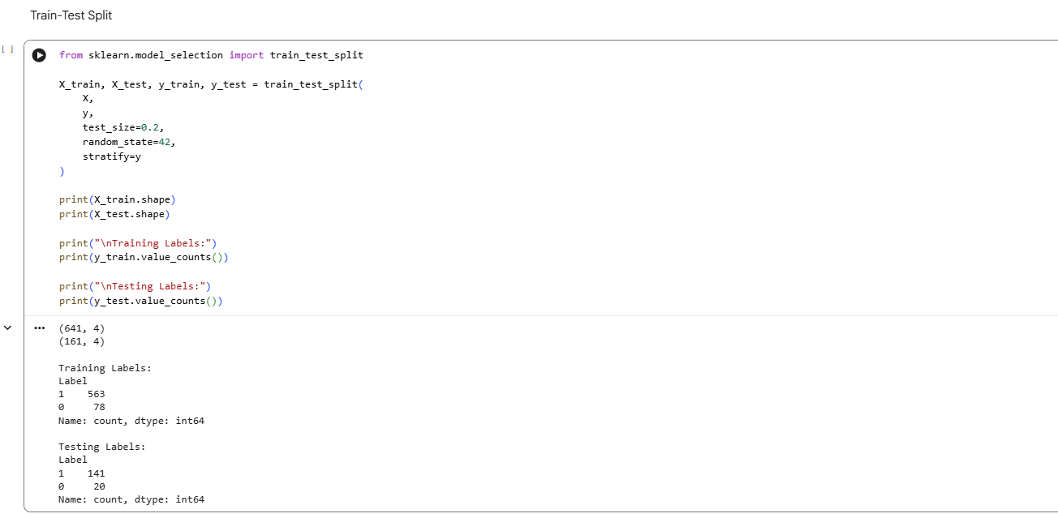
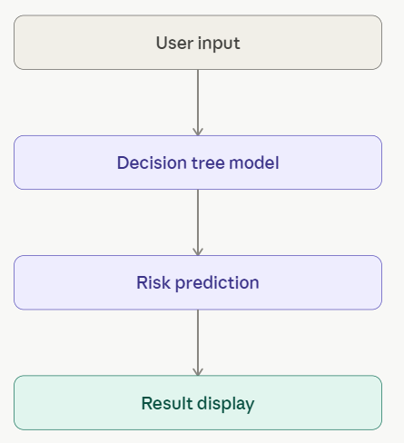
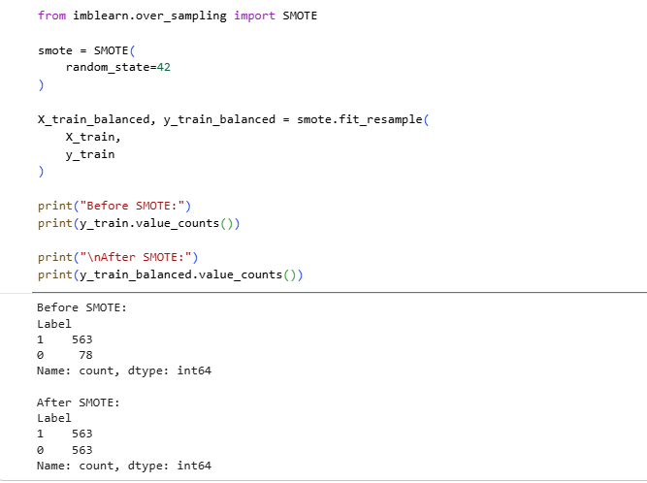
Streamlit Dashboard
Application Features
Home Page
Package Risk Prediction
Dataset Analytics
Model Comparison
Feature Importance
Key Takeaway
Interactive dashboard enables real-time package risk assessment.
Notes:
To demonstrate practical implementation, the selected Decision Tree model was deployed within an interactive Streamlit web application. The dashboard includes a homepage summarising the project, a package risk prediction interface where users enter package metadata, and an analytics section displaying dataset statistics and model performance. This application enables users to perform real-time package risk assessments through a simple graphical interface without requiring machine learning knowledge or programming experience, making the framework suitable for practical cybersecurity use.

Slide 12
Contributions
Academic Contributions
Lightweight ML-based detection framework.
Metadata-driven attack prediction.
External validation using OpenSSF.
Comparative evaluation of three ML models.
Practical Contributions
Streamlit deployment.
Early warning system.
Scalable architecture.
Reduced computational cost.
Key Message
The framework improves software supply chain security through efficient pre-installation detection.
Notes:
This research has both theoretical and applied implications. Academically, it presents a lightweight framework based on metadata for detection dependency confusion and typosquatting attacks prior to package installation. It also offers an external validation of the comparative evaluation of three supervised machine learning algorithms. In practice, the study shows how metadata analysis can be incorporated into an interactive Streamlit application, allowing software developers to conduct an early package risk assessment, while significantly lowering the computational cost of traditional approaches for malware detection.

Slide 13
Project Management
Major Phases
Literature Review
Dataset Collection
Feature Engineering
Model Development
Evaluation
Dashboard Development
Dissertation Writing
Project Outcome
All planned milestones successfully completed.
Notes:
The project was finished in the specified development schedule. The early work was targeted towards literature review and problems analysis, then, data collection and feature engineering. A machine learning model was subsequently built, tested and compared before finally being deployed in the Streamlit application with the model which was the best. The last part of the work involved result analysis, writing the dissertation and preparing the presentation. All the research objectives have been achieved in a structured way which ensured the quality of the project and the submission on time.

Slide 14
Conclusion
Research Summary
Successfully developed a lightweight ML framework.
Constructed labelled training and validation datasets.
Compared three supervised learning models.
Decision Tree achieved the best overall performance.
Streamlit application demonstrated practical implementation.
Final Takeaway
Metadata-based machine learning can effectively detect software supply chain attacks before package installation.
Notes:
Finally, this research was able to create a lightweight machine learning model to identify suspicious Python packages before installation. The proposed solution was a viable one that aimed to solve a significant research problem, and used package metadata, which is publicly accessible, instead of source code analysis, which is costly. The Decision Tree Classifier displayed the best overall performance and was deployed with a user-friendly Streamlit application. In conclusion, the study shows that metadata-based machine learning offers an efficient and scalable approach to enhance the security of software supply chains.

Slide 15
References
[1] | A. O. OLANIYI, M. G. Adewunmi, and O. A. A. Ayeni, “Machine Learning Model for Detecting Attack in Service Supply Chain,” Journal of Information Security and Cybercrimes Research, vol. 8, no. 1, pp. 01–16, June 2025, doi: https://doi.org/10.26735/gnvr4188.
[2] | S. Ismail, S. Dandan, D. W. Dawoud, and H. Reza, “A Comparative Study of Lightweight Machine Learning Techniques for Cyber-Attacks Detection in Blockchain-Enabled Industrial Supply Chain,” IEEE Access, vol. 12, pp. 102481–102491, 2024, doi: https://doi.org/10.1109/access.2024.3432454.
[3] | X. Zheng et al., “Towards Robust Detection of Open Source Software Supply Chain Poisoning Attacks in Industry Environments,” arXiv (Cornell University), pp. 1990–2001, Oct. 2024, doi: https://doi.org/10.1145/3691620.3695262.
[4] | T. Mens and A. Decan, “An Overview and Catalogue of Dependency Challenges in Open Source Software Package Registries,” arXiv.org, 2024. https://arxiv.org/abs/2409.18884 (accessed July 08, 2026).
[5] | S. Pang, Y. Yao, Z. Jiang, Z. Fan, H. Li, and B. Liu, “PYPILINE: Malicious PyPI Package Detection via Suspicious API Knowledge and Agent Workflow,” arXiv.org, 2026. https://arxiv.org/abs/2606.19063 (accessed July 08, 2026).
[6] | H. Samaana, D. E. Costa, E. Shihab, and A. Abdellatif, “A Machine Learning-Based Approach For Detecting Malicious PyPI Packages,” Proceedings of the 40th ACM/SIGAPP Symposium on Applied Computing, pp. 1617–1626, Mar. 2025, doi: https://doi.org/10.1145/3672608.3707756.
[7] | S. Halder et al., “Malicious Package Detection using Metadata Information,” Proceedings of the ACM Web Conference 2022, pp. 1779–1789, May 2024, doi: https://doi.org/10.1145/3589334.3645543.

